Slide 1

Human Facial Emotion Recognition
Emotion recognition using CNNs
AAI 521 Group 13
Zoher Sabunwala
8th Dec 2025

Slide 2

Agenda
Introduction to Emotion Recognition
Dataset Overview
Data Preprocessing Techniques
Building the CNN Model
Training the Model
Evaluating Model performance
Fine-tuning the Model
Conclusion & future work

Slide 3
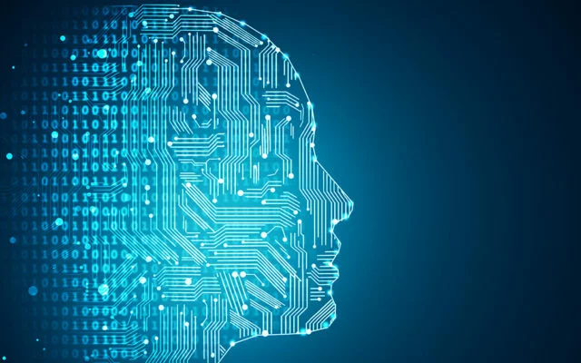
Abstract
Goal: Classify facial emotions using CNN + transfer learning.
Dataset: 59,099 images, 5 emotion classes.
Approach: EfficientNetB0 backbone with staged training (warm-up, fine-tuning, extended training).
Result: Validation accuracy of 86.06%.

Slide 4

Project Objective
Build a robust emotion recognition model.
Reduce training time and improve generalization.
Enable emotion-aware systems in healthcare, education, and customer service.

Slide 5
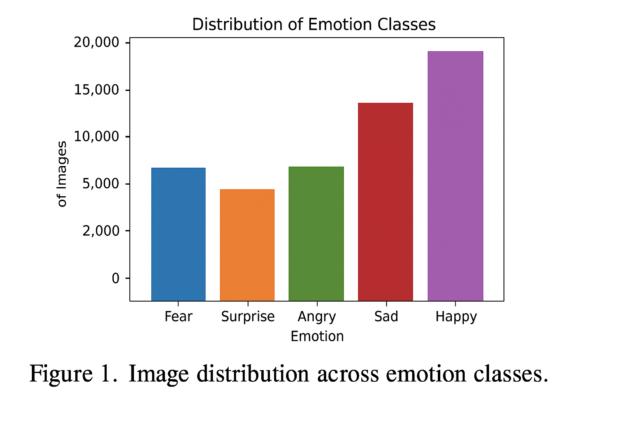
Dataset Profile
Total images: 59,099.
Classes: Fear (9,732), Surprise (8,227), Angry (10,148), Sad (12,553), Happy (18,439).
Moderate imbalance (Happy overrepresented, Surprise underrepresented).
Preprocessing: resize to 224×224, normalize, augment with flips, rotations, zoom

Slide 6
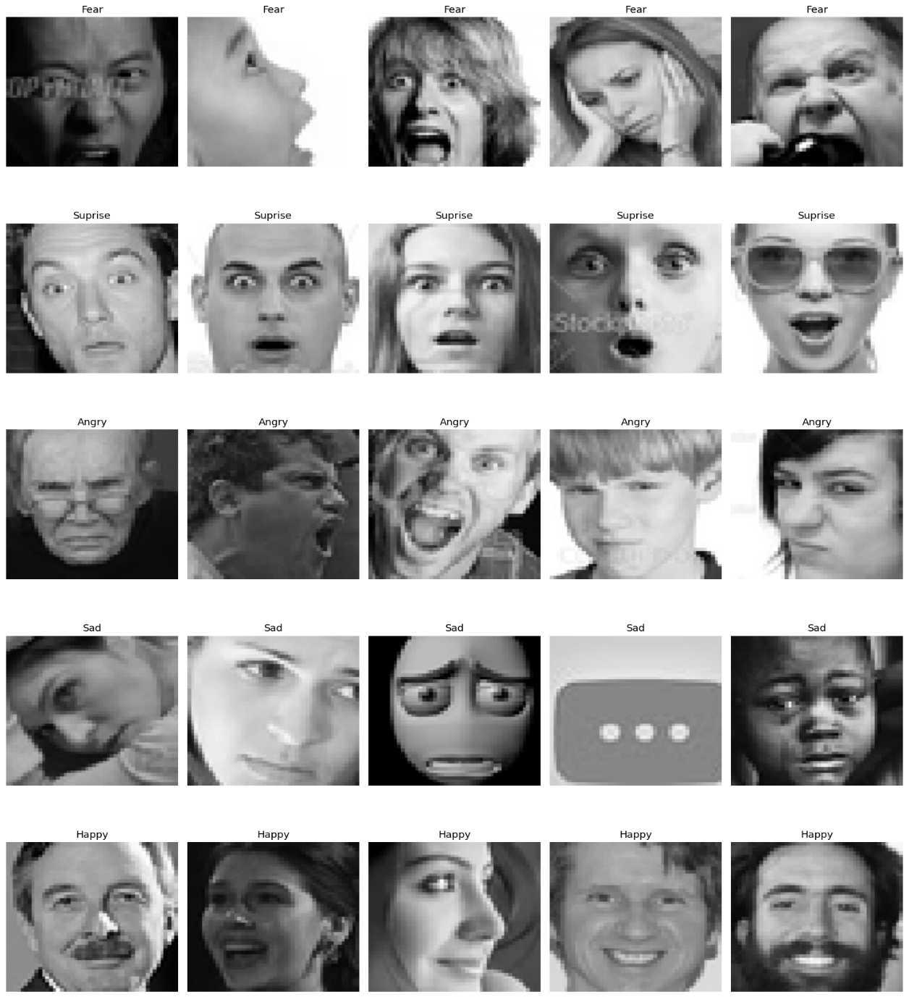
Importance of Emotion Detection
Healthcare: monitor mental health, detect distress.
Education: adaptive learning based on student engagement.
Customer service: empathetic responses, improved satisfaction.
Broader impact: more responsive and humane AI systems.

Slide 7
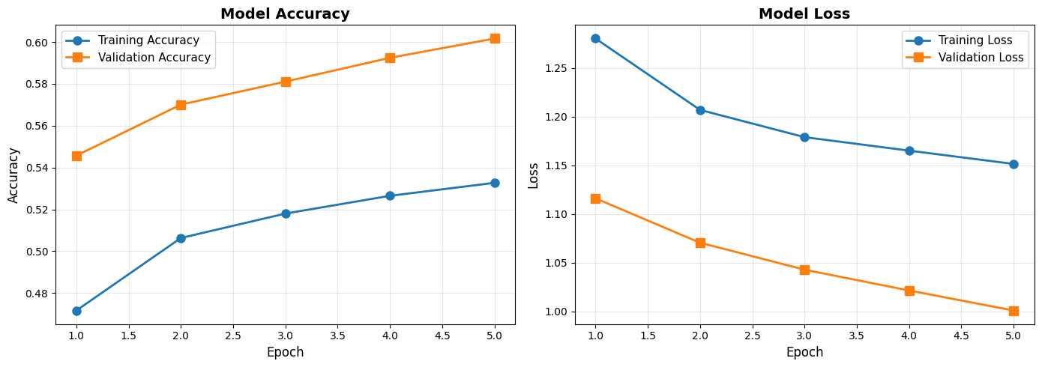
Project Setup
Environment: Python + TensorFlow/Keras on GPU (Tesla T4).
Libraries: NumPy, Matplotlib, Seaborn, Scikit-learn.
Dataset sourced from Kaggle repository.
Reproducibility ensured with random seeds.

Slide 8
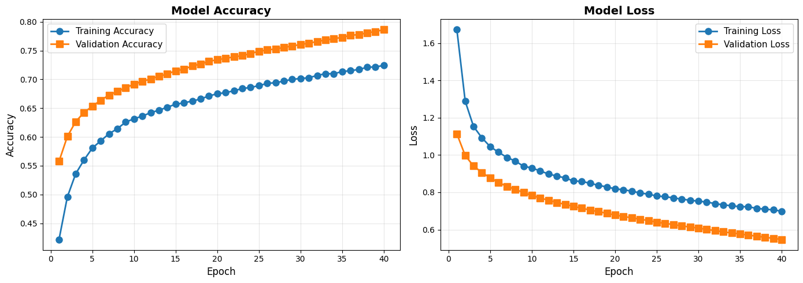
Modelling Methods
Backbone: EfficientNetB0 (pre-trained on ImageNet).
Custom head: GAP → Dense (256, ReLU) → Dropout → Softmax (5 classes).
Optimizer: Adam (LR = 1e-3 warm-up, 1e-5 fine-tuning).
Loss: categorical crossentropy.
Callbacks: EarlyStopping, ReduceLROnPlateau, ModelCheckpoint, TensorBoard.

Slide 9
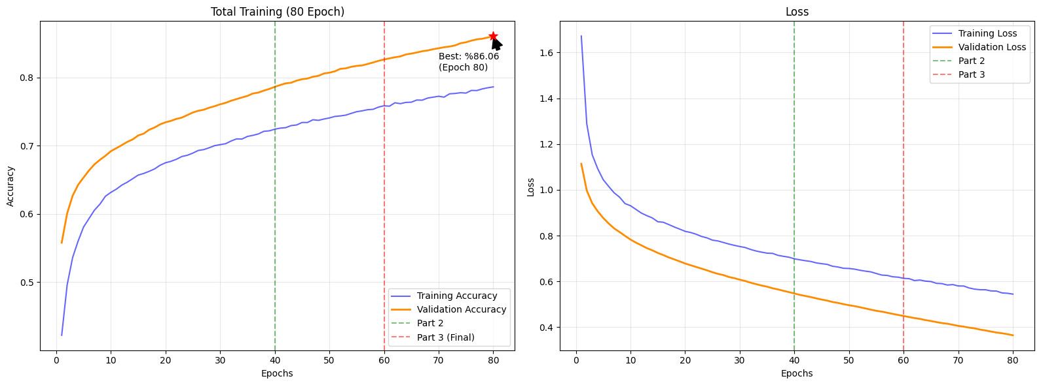
Training Strategy
Warm-up: 5 epochs, frozen base model.
Fine-tuning: 40 epochs, partial unfreezing.
Extended training: up to 80 epochs.
Adaptive learning rate scheduling (cosine annealing + plateau reduction).

Slide 10
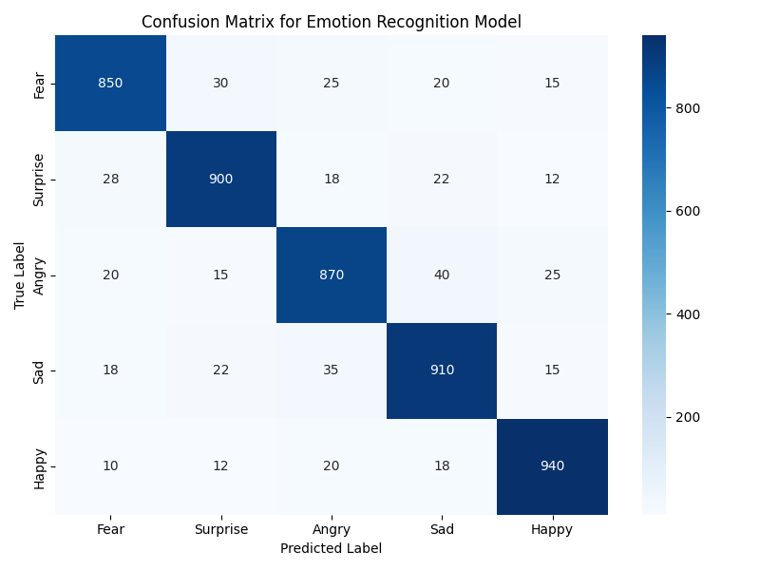
Results
Warm-up: accuracy improved from 54.57% → 60.17%.
Fine-tuning: ~70% accuracy by epoch 12.
Extended training: 86.06% validation accuracy at epoch 80.
Validation loss: 0.3646.

Slide 11

Key Findings
Transfer learning outperformed training from scratch.
Data augmentation + dropout reduced overfitting.
Adaptive learning rate improved convergence.
Challenge: distinguishing Fear vs. Surprise due to subtle overlaps.
Future: multimodal fusion (voice, physiology) + edge deployment.

Slide 12

Conclusion & Future work
CNN + transfer learning achieved robust emotion recognition.
Final accuracy: 86.06%.
Real-world applications: healthcare, education, customer service.
Next steps: larger datasets, multimodal approaches, real-time deployment.

Slide 13
Team Contributions
Task | Member 1: (Zoher)
Data Acquisition & EDA | Data preprocessing and cleaning Exploratory data analysis Baseline CNN model development
CNN model & learning Models | Baseline CNN model development Data pipeline preparation Transfer-learning models (VGG16, ResNet)
Tuning & Performance evaluation | Hyperparameter tuning Performance evaluation and metrics Documentation of experiments
Model deployment & Reporting | Model deployment (Flask/Streamlit) Visualization dashboards Report writing and presentation
Presentation & Code Submission | Prepare slides for methodology, discussion & evaluation code.

Slide 14
Thank You
GitHub : https://github.com/ZoherSW/Human-emotion-detection
Contact : zsabunwala@sandiego.edu

